Slide 1

Contraceptive methods: overview
"Family Planning”: An Online Evidence-based Course 2021
Raqibat Idris, MBBS, DO, MPH
Geneva Foundation for Medical Education and Research

Slide 2
Outline
Definitions
Key facts about contraception / family planning
Benefits of family planning and contraception
Contraceptive methods
Comparing effectiveness of family planning methods
Contraceptive use by method

Slide 3
Definitions
What is contraception?
Contraception is the intentional prevention of pregnancy by artificial or natural means.
What is family planning?
Family planning allows individuals and couples to anticipate and attain their desired number of children and the spacing and timing of their births. It is achieved through use of contraceptive methods and the treatment of involuntary infertility.
What is an unmet need for family planning?
An unmet need for family planning is the number of women that want to stop or delay childbearing but are not using any method of contraception to prevent pregnancy, including also pregnant women whose pregnancies were unwanted or mistimed at the time of conception, and postpartum amenorrhoeic women who are not using family planning and whose last birth was unwanted or mistimed.
Training Resource Package for Family Planning – Benefits of Family Planning.
United Nations, Department of Economic and Social Affairs, Population Division. Contraceptive Use by Method 2019: Data Booklet (ST/ESA/SER.A/435). United Nations; 2019.

Slide 4
Key facts about contraception / family planning
Among the 1.9 billion Women of Reproductive Age group (15-49 years) worldwide in 2019, 1.1 billion have a need for family planning; of these, 842 million are using contraceptive methods, and 270 million have an unmet need for contraception.
Use of contraception prevents pregnancy-related health risks for women, especially for adolescent girls.
Only one contraceptive method, condoms, can prevent both a pregnancy and the transmission of sexually transmitted infections, including HIV.
Use of contraception advances the human right of people to determine the number and spacing of their children.
Contraception offers a range of potential non-health benefits that encompass expanded education opportunities and empowerment for women, and sustainable population growth and economic development for countries.
The proportion of the need for family planning satisfied by modern methods, Sustainable Development Goals (SDG) indicator 3.7.1, was 75.7% globally in 2019, yet less than half of the need for family planning was met in Middle and Western Africa.
WHO. Family planning/contraception methods. World Health Organization; 2020.
Notes:
923 million women of reproductive age want to avoid a pregnancy in Low- and Middle-Income Countries. 218 million of them have an unmet need for modern contraception.
Source: Guttmacher Institute. Adding It Up - Investing in Sexual and Reproductive Health in Low- and Middle-Income Countries. Fact Sheet. Guttmacher Institute, 2020 Jul.
Modern contraceptive prevalence among Married women of reproductive age (MWRA) increased worldwide between 2000 and 2019 by 2.1 percentage points from 55.0% (95% UI 53.7%–56.3%) to 57.1% (95% UI 54.6%–59.5%). Reasons for this slow increase include:
Reasons for unmet need for contraception
a limited choice of methods
limited access to services, particularly among young, poorer and unmarried people
a fear or experience of side-effects
cultural or religious opposition
poor quality of available services
users’ and providers’ bias against some methods
gender-based barriers to accessing services
Source: WHO. Family planning/contraception methods. World Health Organization; 2020.

Slide 5
Increased risk of having problems during pregnancy and delivery
Some women have an increased risk of having problems during pregnancy and delivery. They are women who:
Are under the age of 18, or over age 35
Become pregnant less than 2 years after a previous live birth
Become pregnant less than six months post-abortion or post-miscarriage
Have too many children (high parity)
Have certain existing health problems
Do not have access to skilled health care
Problems are more likely in those with multiple risk factors.
Training Resource Package for Family Planning – Benefits of Family Planning.
Notes:
Research shows that women in the categories listed in this slide are at greater risk for problems during pregnancy and delivery, making access to family planning even more critical.
Source: Training Resource Package for Family Planning - Benefits of Family Planning.

Slide 6
Benefits of family planning and contraception
Prevents maternal morbidity and mortality
Reduces unsafe abortion from unintended pregnancies
Reduces newborn and infant mortality
Helps to prevent HIV/AIDS
Empowers people and enhances education
Reduces adolescent pregnancies
Contributes to Economic Growth
Secures the well-being and autonomy of women
WHO. Contraception: Evidence brief. World Health Organization; 2019.
Notes:
Prevents maternal morbidity and mortality: Family planning prevents maternal deaths by
Reducing the number of times a woman is exposed to the risks of pregnancy
Helping women avoid unintended and closely spaced pregnancies
Helping women avoid more than 4 births, or births after 35 years of age
If all unmet need for modern contraception were satisfied in developing regions, there would be approximately a three-quarters decline in unintended pregnancies (from the current 89 million to 22 million per year), unplanned births (from 30 million to seven million per year) and induced abortions (from 48 million to 12 million per year).
Fully meeting the unmet need for modern contraception would result in an estimated 76,000 fewer maternal deaths each year.
Reduces unsafe abortion from unintended pregnancies: About 44% of all pregnancies worldwide are unintended, and some 56% of unintended pregnancies end in an induced abortion. Contraception can prevent unsafe abortions by reducing the number of unintended pregnancies.
Reduces newborn and infant mortality: Family planning and contraception can prevent closely spaced and ill-timed pregnancies and births, which contribute to some of the world’s highest infant mortality rates. Closely spaced births result in higher infant mortality: international survey data show that babies born less than two years after their next oldest brother or sister are twice as likely to die in the first year, as those born after an interval of three years. Infants of mothers who die as a result of giving birth also have a greater risk of death and poor health.
Helps to prevent HIV/AIDS:
Women living with HIV have higher unmet need for family planning and reproductive health services than the general population. If the needs of women with HIV for modern contraceptive methods and antiretroviral medication were both fully met, HIV transmission from mothers to newborns would be nearly eliminated—reduced by 93% annually. Male and female condoms provide dual protection against unintended pregnancies and against STIs including HIV.
Empowers people and enhances education: Family planning and contraception enables people to make informed choices about their sexual and reproductive health, and creates an opportunity for women for enhanced education and participation in society, including paid employment. Early and unintended pregnancy can be both a cause and a consequence of dropping out of school.
Reduces adolescent pregnancies: Pregnant adolescents are more likely to have preterm and low birth-weight babies. Babies born to adolescents have higher rates of neonatal mortality. Many adolescent girls who become pregnant have to leave school. This has long-term implications for them as individuals, their families and communities.
Contributes to Economic Growth: Rapid fertility decline, which is linked to increased contraceptive use, lowers the ratio of dependents to income earners. This results in a higher proportion of wage earners and leads to national savings. With supportive socioeconomic policies and attention to equity, countries can then experience a “demographic dividend” of rapid economic growth.
Secures the well-being and autonomy of women: Promotion of family planning – and ensuring access to preferred contraceptive methods for women, girls and couples – is essential to securing the well-being and autonomy of women, while supporting the health and development of communities.
Source: WHO. Contraception: Evidence brief. World Health Organization; 2019.

Slide 7
Contraceptive methods
There are different types of contraception. They can be short acting or long acting, reversible or permanent.
Health care providers play an important role in helping people find and use a method that is both effective and acceptable.
The different methods of contraception have varying rates of effectiveness depending on correct usage. (See next few slides)

Slide 8
Contraceptive methods
Hormonal Progestogen-only contraceptives Progestogen-only pills (POPs) Progestogen-only injectable contraceptives (POIs) Progestogen-only implants Progesterone-Releasing Vaginal Ring Combined hormonal contraceptives Combined oral contraceptives (COCs) Combined contraceptive patch Combined contraceptive vaginal ring (CVR) Combined injectable contraceptives (CICs)
Emergency contraception (EC) or postcoital contraception Copper-bearing IUDs (Cu-IUD) for EC Emergency contraceptive pills (ECPs)
Intrauterine devices (IUDs) Copper-bearing IUDs (Cu-IUD) Levonorgestrel-releasing IUDs (LNG-IUD)
Permanent methods Female sterilization (tubal ligation) Male sterilization (vasectomy)
Barrier methods Male and female condoms Other barrier methods
Spermicides
Fertility awareness methods Standard Days Method (SDM) Others
Lactational amenorrhea method
WHO. Contraception. World Health Organization; 2021.
Notes:
Hormonal contraceptive methods are usually oral pills or implants, patches or vaginal rings. They release small amounts of one or more hormones which prevent ovulation.
Intrauterine devices (IUDs) are devices inserted into the uterus where they release either a copper component or a small amount of a hormone (Levonorgestrel) to prevent the sperm from reaching the egg.
Emergency contraception is used within a five-day window to prevent pregnancy after unprotected sex or if contraception has failed, either with a pill or with an IUD.
Condoms: Both male and female condoms form a barrier that prevent sperm and egg from meeting. Male condoms sheath a penis. Female condoms fit loosely inside a vagina.
Sterilization is considered a permanent method that blocks sperm in men and eggs in women. Voluntary and informed choice is essential.
Lactational amenorrhea method is a temporary method of contraception for new mothers whose monthly bleeding has not returned. During this period, eggs are not released and so pregnancy cannot occur.
Source: WHO. Contraception. World Health Organization; 2021.

Slide 9
Mechanisms of action and effectiveness of contraceptive methods - 1
Method | How it works | Effectiveness: pregnancies per 100 women per year with consistent and correct use | Effectiveness: pregnancies per 100 women per year as commonly used
Combined oral contraceptives (COCs) or “the pill” | Prevents the release of eggs from the ovaries (ovulation) | 0.3 | 7
Progestogen-only pills (POPs) or "the minipill" | Thickens cervical mucous to block sperm and egg from meeting and prevents ovulation | 0.3 | 7
Implants | Thickens cervical mucous to blocks sperm and egg from meeting and prevents ovulation | 0.1 | 0.1
Progestogen only injectables | Thickens cervical mucous to block sperm and egg from meeting and prevents ovulation | 0.2 | 4
Monthly injectables or combined injectable contraceptives (CIC) | Prevents the release of eggs from the ovaries (ovulation) | 0.05 | 3
Combined contraceptive patch and combined contraceptive vaginal ring (CVR) | Prevents the release of eggs from the ovaries (ovulation) | 0.3 (for patch) 0.3 (for vaginal ring) | 7 (for patch) 7 (for contraceptive vaginal ring)
Intrauterine device (IUD): copper containing | Copper component damages sperm and prevents it from meeting the egg | 0.6 | 0.8
Intrauterine device (IUD) levonorgestrel | Thickens cervical mucous to block sperm and egg from meeting | 0.5 | 0.7
Male condoms | Forms a barrier to prevent sperm and egg from meeting | 2 | 13
Female condoms | Forms a barrier to prevent sperm and egg from meeting | 5 | 21
WHO. Family planning/contraception methods. World Health Organization; 2020.
Notes:
Methods of contraception include oral contraceptive pills, implants, injectables, patches, vaginal rings, Intra uterine devices, condoms, male and female sterilization, lactational amenorrhea methods, withdrawal and fertility awareness based methods. These methods have different mechanisms of action and effectiveness in preventing unintended pregnancy. Effectiveness of methods is measured by the number of pregnancies per 100 women using the method per year.
Methods are classified by their effectiveness as commonly used into:
Very effective (0–0.9 pregnancies per 100 women);
Effective (1-9 pregnancies per 100 women);
Moderately effective (10-19 pregnancies per 100 women);
Less effective (20 or more pregnancies per 100 women).
Source: WHO. Family planning/contraception methods. World Health Organization; 2020.

Slide 10
Mechanisms of action and effectiveness of contraceptive methods - 2
Method | How it works | Effectiveness: pregnancies per 100 women per year with consistent and correct use | Effectiveness: pregnancies per 100 women per year as commonly used
Male sterilization (Vasectomy) | Keeps sperm out of ejaculated semen | 0.1 | 0.15
Female sterilization (tubal ligation) | Eggs are blocked from meeting sperm | 0.5 | 0.5
Lactational amenorrhea method (LAM) | Prevents the release of eggs from the ovaries (ovulation) | 0.9 (in six months) | 2 (in six months)
Standard Days Method or SDM | Prevents pregnancy by avoiding unprotected vaginal sex during most fertile days. | 5 | 12
Basal Body Temperature (BBT) Method | Prevents pregnancy by avoiding unprotected vaginal sex during fertile days | Reliable effectiveness rates are not available
TwoDay Method | Prevents pregnancy by avoiding unprotected vaginal sex during most fertile days, | 4 | 14
Sympto-thermal Method | Prevents pregnancy by avoiding unprotected vaginal sex during most fertile | <1 | 2
Emergency contraception pills (ulipristal acetate 30 mg or levonorgestrel 1.5 mg) | Prevents or delays the release of eggs from the ovaries. Pills taken to prevent pregnancy up to 5 days after unprotected sex | < 1 for ulipristal acetate ECPs 1 for progestin-only ECPs 2 for combined estrogen and progestin ECPs
Calendar method or rhythm method | The couple prevents pregnancy by avoiding unprotected vaginal sex during the 1st and last estimated fertile days, by abstaining or using a condom. | Reliable effectiveness rates are not available | 15
Withdrawal (coitus interruptus) | Tries to keep sperm out of the woman's body, preventing fertilization | 4 | 20
WHO. Family planning/contraception methods. World Health Organization; 2020.
Notes:
Methods of contraception include oral contraceptive pills, implants, injectables, patches, vaginal rings, Intra uterine devices, condoms, male and female sterilization, lactational amenorrhea methods, withdrawal and fertility awareness based methods. These methods have different mechanisms of action and effectiveness in preventing unintended pregnancy. Effectiveness of methods is measured by the number of pregnancies per 100 women using the method per year.
Methods are classified by their effectiveness as commonly used into:
Very effective (0–0.9 pregnancies per 100 women);
Effective (1-9 pregnancies per 100 women);
Moderately effective (10-19 pregnancies per 100 women);
Less effective (20 or more pregnancies per 100 women).
Source: WHO. Family planning/contraception methods. World Health Organization; 2020.

Slide 11
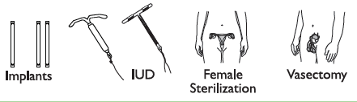

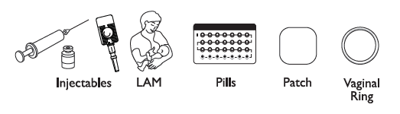
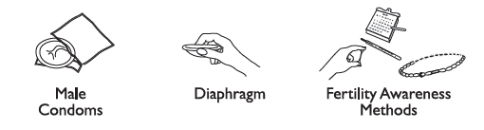
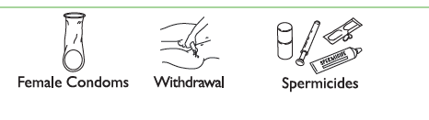
Comparing Effectiveness of Family Planning Methods
More effective
Less than 1 pregnancy per
100 women in one year
How to make your
method more effective
Implants, IUD, female sterilization:
After procedure, little or nothing to do or remember
Vasectomy: Use another method for first
3 months
Injectables: Get repeat injections on time
Lactational Amenorrhea Method (for 6 months): Breastfeed often, day and night
Pills: Take a pill each day
Patch, ring: Keep in place, change on time
Male condoms, diaphragm: Use correctly every time you have sex
Fertility awareness methods: Abstain or use condoms on fertile days. Standard Days Method and Two-Day Method may be easier to use.
Female condoms, withdrawal, spermicides: Use correctly every time you have sex
Less effective
About 30 pregnancies per
100 women in one year
Family Planning: A Global Handbook for Providers (3rd Edition, 2018)
Notes:
Methods of contraception have different mechanisms of action and effectiveness in preventing unintended pregnancy. Effectiveness of methods is measured by the number of pregnancies per 100 women using the method per year.

Slide 12
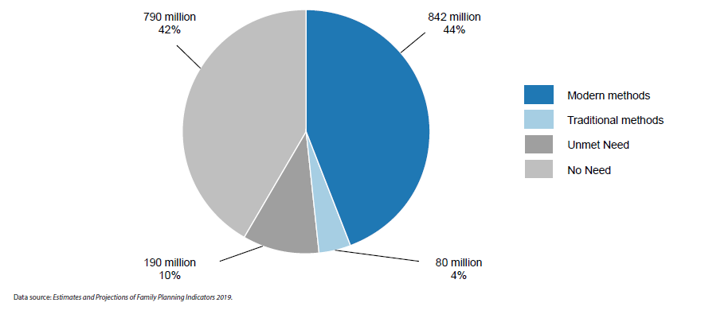
Estimated numbers of women of reproductive age (15-49 years) using modern and traditional contraceptive methods, having an unmet need for family planning and no need for family planning, worldwide, 2019
Contraceptive use by method
Contraceptive Use by Method 2019: Data Booklet (ST/ESA/SER.A/435). United Nations; 2019.
Notes:
Worldwide, 922 million women of reproductive age (or their partners) are contraceptive users
Among the 1.9 billion women of reproductive age (15-49 years) living in the world in 2019, 1.1 billion have a need for family planning, that is, they are either current users of contraceptives—842 million use modern methods of contraception and 80 million use traditional methods—or have an unmet need for family planning—190 million women want to avoid pregnancy and do not use any contraceptive method.* The proportion of women who have their need for family planning satisfied by modern methods (Sustainable Development Goals indicator 3.7.1) is 76 per cent in 2019. **
* Women who want to avoid pregnancy and do not use any contraceptive method are considered to have an unmet need for family planning, which is defined as the number of women that want to stop or delay childbearing but are not using any method of contraception to prevent pregnancy, including also pregnant women whose pregnancies were unwanted or mistimed at the time of conception, and postpartum amenorrhoeic women who are not using family planning and whose last birth was unwanted or mistimed.
** The indicator is defined as the number of women who are currently using, or whose sexual partner is currently using, at least one modern contraceptive method as a proportion of the number of women of reproductive age who are either using any method of contraception or having an unmet need for family planning.
Source: United Nations, Department of Economic and Social Affairs, Population Division. Contraceptive Use by Method 2019: Data Booklet (ST/ESA/SER.A/435). United Nations; 2019.

Slide 13
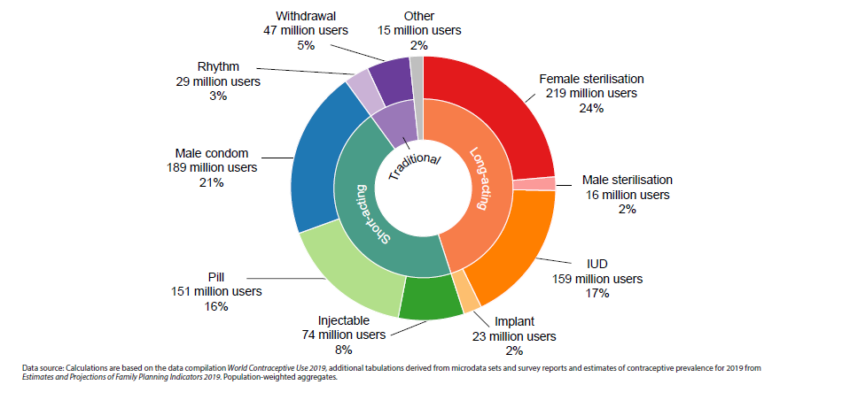
Estimated numbers of women of reproductive age (15-49 years) using various contraceptive methods, worldwide, 2019
Contraceptive use by method
Contraceptive Use by Method 2019: Data Booklet (ST/ESA/SER.A/435). United Nations; 2019.
Notes:
Female sterilisation and male condom are the two most common methods used worldwide
Female sterilisation is the most common contraceptive method used worldwide. In 2019, 23.7 per cent of women who are currently using contraception—that is 219 million women—rely on female sterilisation. Three other methods have more than 100 million users worldwide, male condom (189 million), IUD (159 million) and the pill (151 million). Overall, 45.2 per cent of contraceptive users rely on permanent or long-acting methods (female and male sterilisation, IUD, implant), 46.1 per cent on a short-acting method (such as male condom, the pill, injectable and other modern methods) and 8.7 per cent on traditional methods (withdrawal, rhythm methods and other traditional methods).
Source: United Nations, Department of Economic and Social Affairs, Population Division. Contraceptive Use by Method 2019: Data Booklet (ST/ESA/SER.A/435). United Nations; 2019.

Slide 14
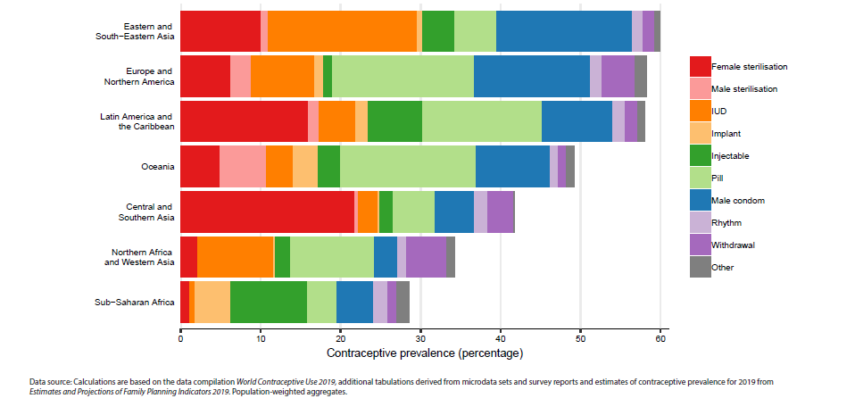
Contraceptive prevalence by method among women of reproductive age (15-49 years), by region, 2019
Contraceptive use by method
Contraceptive Use by Method 2019: Data Booklet (ST/ESA/SER.A/435). United Nations; 2019.
Notes:
Contraceptive methods most commonly used vary widely by region
In Eastern and South-Eastern Asia, IUD is the most common contraceptive method used (18.6 per cent of women rely on this method), followed closely by male condom (17.0 per cent). In Europe and Northern America, the pill and male condom are the most commonly used methods (17.8 and 14.6 per cent of women, respectively), while in Latin America and the Caribbean it is female sterilisation and the pill (16.0 and 14.9 per cent, respectively). In Oceania, the dominant method is the pill (16.9 per cent) and in Central and Southern Asia it is female sterilisation (21.8 per cent of women rely on this method). In Northern Africa and Western Asia, the two most common methods are the pill (10.5 per cent) and IUD (9.5 per cent). Sub-Saharan Africa is the only region in which injectables are the dominant method with a prevalence of 9.6 per cent among women of reproductive age.
Source: United Nations, Department of Economic and Social Affairs, Population Division. Contraceptive Use by Method 2019: Data Booklet (ST/ESA/SER.A/435). United Nations; 2019.

Slide 15
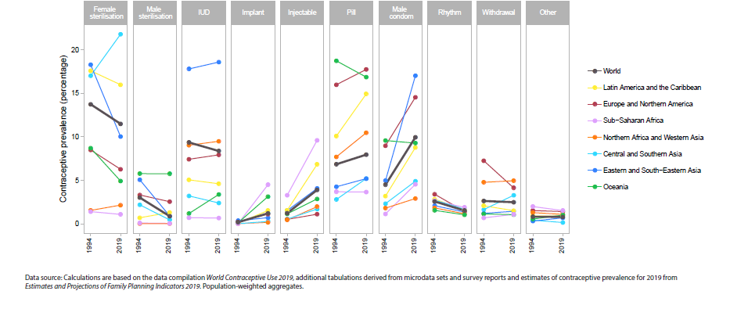
Trends in contraceptive prevalence by method among women of reproductive age (15-49 years), by region, 1994 and 2019
Contraceptive use by method
Contraceptive Use by Method 2019: Data Booklet (ST/ESA/SER.A/435). United Nations; 2019.
Notes:
The prevalence of sterilisation, IUD and traditional methods has declined worldwide since 1994
The prevalence of particular methods has changed slowly at the global and regional levels. The prevalence of female sterilisation worldwide has declined from 13.7 per cent in 1994 to 11.5 per cent in 2019. Central and Southern Asia is the only region where the prevalence of female sterilisation has increased from 17.0 per cent in 1994 to 21.8 per cent in 2019. The prevalence of male sterilisation worldwide has declined from 3.0 to 0.8 per cent during that same period. Globally, as well as in most regions, the prevalence of the pill, IUD, rhythm methods and withdrawal has remained relatively stable over the past 25 years. The prevalence of male condoms has more than doubled worldwide from 4.5 per cent in 1994 to 10.0 per cent in 2019, with the largest increase in Eastern and South-Eastern Asia from 5.0 to 17.0 per cent. As contraceptive use has taken off in sub-Saharan African countries, the prevalence of implants, injectables and male condoms has increased. In Latin America and the Caribbean, the continued increase in contraceptive prevalence is due to the rapid increase in the use of injectables, the pill and male condoms. The prevalence of rhythm methods and withdrawal has been declining since 1994 with the sharpest declines in Europe and Northern America.
Source: United Nations, Department of Economic and Social Affairs, Population Division. Contraceptive Use by Method 2019: Data Booklet (ST/ESA/SER.A/435). United Nations; 2019.

Slide 16
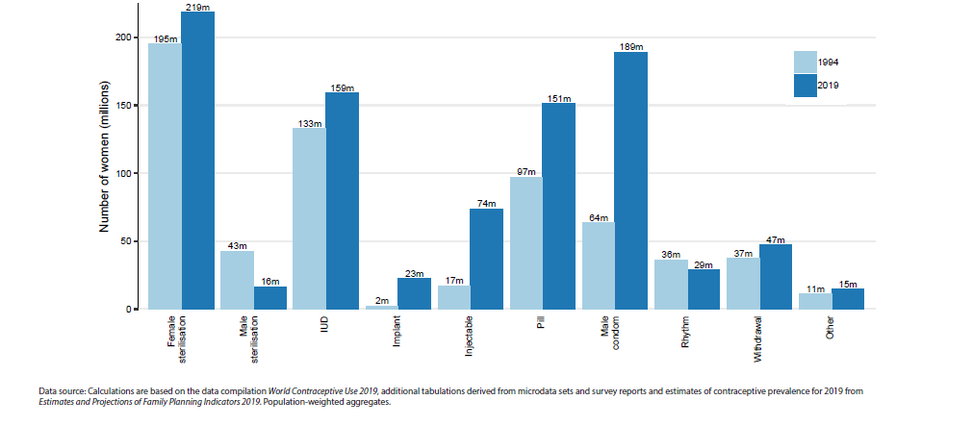
Estimated numbers of women of reproductive age (15-49 years) using various contraceptive methods, 1994 and 2019
Contraceptive use by method
Contraceptive Use by Method 2019: Data Booklet (ST/ESA/SER.A/435). United Nations; 2019.
Notes:
Numbers of users of all methods (apart from male sterilisation and rhythm) have increased
Even though the prevalence of some methods, such as female sterilisation and IUD, have decreased on a global level since 1994, the overall number of women using these methods has grown due to population growth. The number of women relying on female sterilisation has increased between 1994 and 2019 from 195 million to 219 million and the number of women relying on IUD has risen from 133 million to 159 million. Only two methods have seen declines in the number of users over the same period—male sterilisation from 43 million to 16 million users and rhythm methods from 36 million to 29 million. The largest increases have been recorded in the numbers of women relying on male condoms (from 64 million to 189 million) or on injectables (from 17 million to 74 million). It is important that population growth amongst women of reproductive age is taken into account in order to adequately plan for the provision of family planning services, including contraceptive methods.
Source: United Nations, Department of Economic and Social Affairs, Population Division. Contraceptive Use by Method 2019: Data Booklet (ST/ESA/SER.A/435). United Nations; 2019.

Slide 17
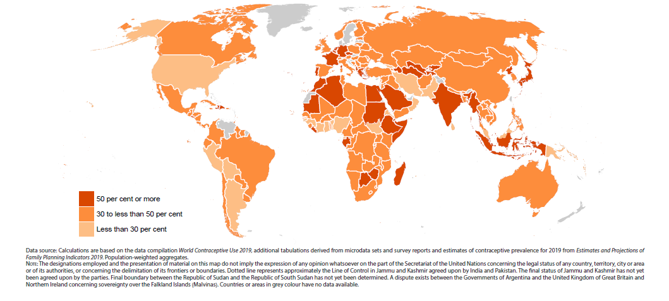
Percentage share of contraceptive use for the most common method among women of reproductive age (15- 49 years), 2019
Contraceptive use by method
Contraceptive Use by Method 2019: Data Booklet (ST/ESA/SER.A/435). United Nations; 2019.
Notes:
In one fifth of countries, one contraceptive method accounts for half or more of all contraceptive use
In at least one out of every five countries or areas, a single method accounts for 50 per cent or more of all contraceptive use. In the 37 countries or areas where one method constitutes half or more of all use in 2019, the dominant methods include the pill (13 countries), IUD, injectable and male condom (6 countries each), female sterilisation (4 countries) and a traditional method (3 countries). In an additional 113 countries, the most common contraceptive method accounts for between 30 and 49 per cent of total use. Countries where contraceptive practice is heavily concentrated on one or two methods can be found in all regions and at all levels of overall contraceptive prevalence.
Source: United Nations, Department of Economic and Social Affairs, Population Division. Contraceptive Use by Method 2019: Data Booklet (ST/ESA/SER.A/435). United Nations; 2019.

Slide 18
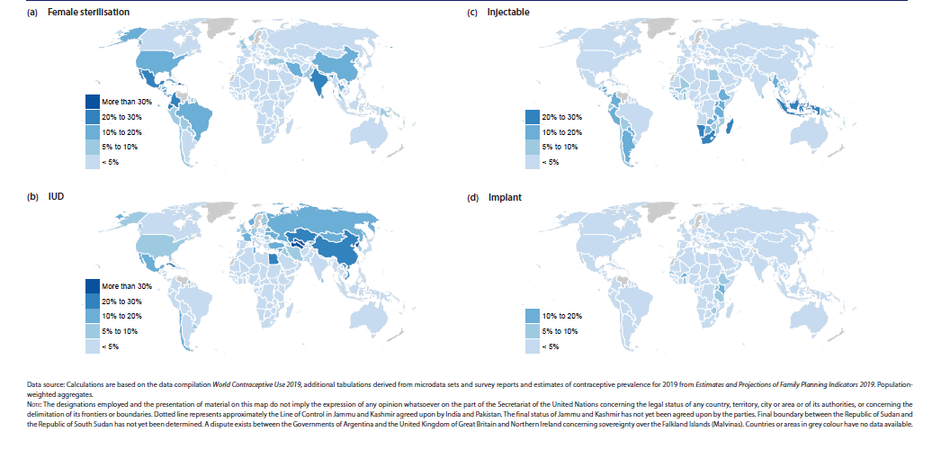
Estimated prevalence of individual contraceptive methods among women of reproductive age (15-49 years), 2019 - I
Contraceptive use by method
Contraceptive Use by Method 2019: Data Booklet (ST/ESA/SER.A/435). United Nations; 2019.
Notes:
Female sterilisation and IUD are highly prevalent in only a handful of countries
Female sterilisation and IUD, while among the most common methods of contraception globally, are used by more than one fifth of women of reproductive age in only eight countries each. Female sterilisation has the highest prevalence in the Dominican Republic (30.6 per cent) and India (29.0 per cent). The highest prevalence of IUD is in the Democratic People’s Republic of Korea (46.9 per cent) and Uzbekistan (36.9 per cent). Injectables are used mainly in sub-Saharan Africa and South-Eastern Asia and the prevalence is over 20 per cent in Indonesia, Madagascar, Malawi, Namibia and South Africa. Implants are commonly used in only a handful of countries in sub-Saharan Africa, with the highest prevalence in Kenya (14.9 per cent).
Source: United Nations, Department of Economic and Social Affairs, Population Division. Contraceptive Use by Method 2019: Data Booklet (ST/ESA/SER.A/435). United Nations; 2019.

Slide 19
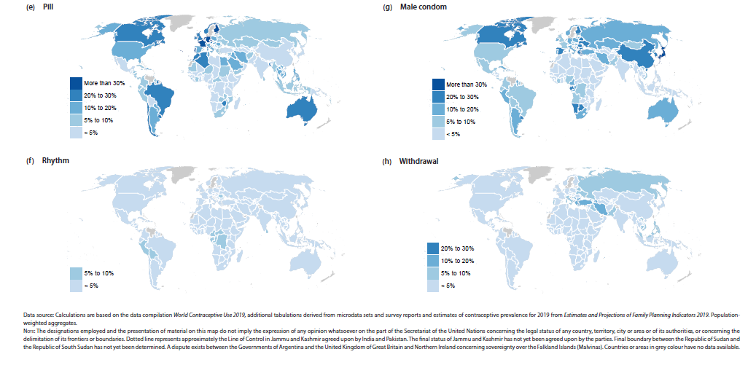
Estimated prevalence of individual contraceptive methods among women of reproductive age (15-49 years), by country, 2019 - II
Contraceptive use by method
Contraceptive Use by Method 2019: Data Booklet (ST/ESA/SER.A/435). United Nations; 2019.
Notes:
The contraceptive pill and male condom are commonly used methods in many countries
The pill is used by over 20 per cent of women of reproductive age in 27 countries worldwide, with the highest prevalence in European countries. Male condom use is most prevalent in Japan (34.9 per cent) and Hong Kong, Special Administrative Region of China (32.1 per cent) and the prevalence is more than 20 per cent in 22 countries. Rhythm methods and withdrawal are the two most commonly used traditional methods of contraception. The highest prevalence of withdrawal is in Albania (24.5 per cent) and of rhythm methods in Congo and Cameroon (9.5 and 9.1 per cent, respectively).
Source: United Nations, Department of Economic and Social Affairs, Population Division. Contraceptive Use by Method 2019: Data Booklet (ST/ESA/SER.A/435). United Nations; 2019.

Slide 20
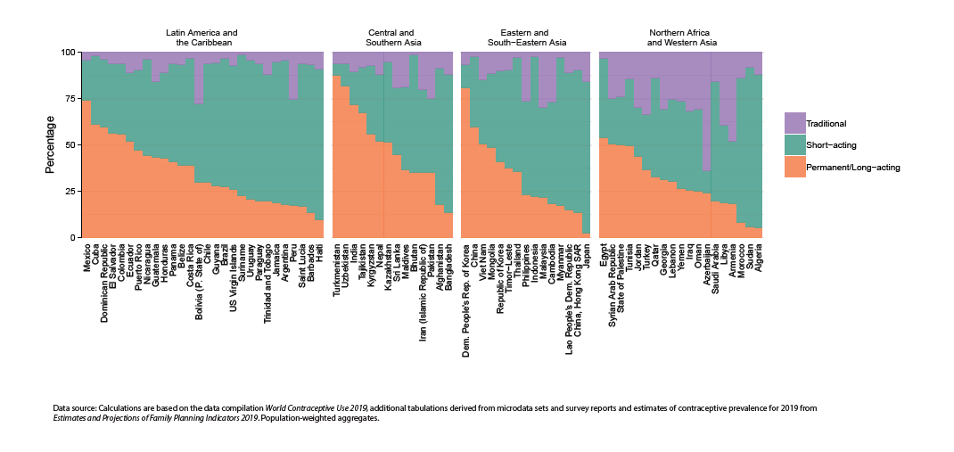
Estimated proportions of contraceptive users among women of reproductive age (15-49 years) using permanent or long-acting modern methods, short-acting modern methods and traditional methods in 2019, by country and region - I
Contraceptive use by method
Contraceptive Use by Method 2019: Data Booklet (ST/ESA/SER.A/435). United Nations; 2019.
Notes:
Permanent and long-acting methods are more common in Asia and in Latin America and the Caribbean
Permanent and long-acting methods, such as female and male sterilisation, IUD and implant are more common in Asia and in Latin America and the Caribbean than in other regions. These methods account for more than 50 per cent of all contraceptive use in 20 countries. While the majority of countries in Europe and Northern America rely mainly on short-acting methods of contraception, it should be noted that permanent and long-acting methods are the most common method type used in the United States of America.
Source: United Nations, Department of Economic and Social Affairs, Population Division. Contraceptive Use by Method 2019: Data Booklet (ST/ESA/SER.A/435). United Nations; 2019.

Slide 21
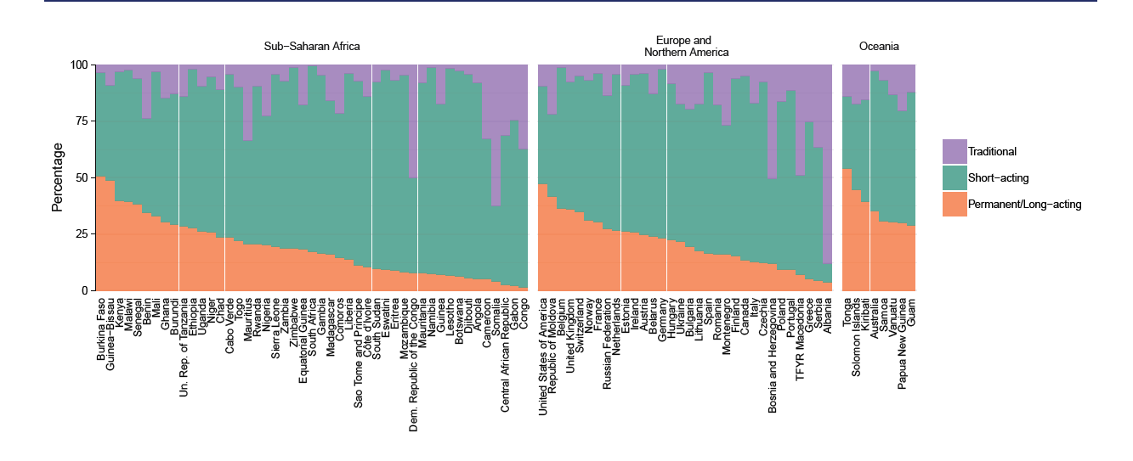
Estimated proportions of contraceptive users among women of reproductive age (15-49 years) using permanent or long-acting modern methods, short-acting modern methods and traditional methods in 2019, by country and region - II
Contraceptive use by method
Contraceptive Use by Method 2019: Data Booklet (ST/ESA/SER.A/435). United Nations; 2019.
Notes:
Short-acting contraceptive methods are more common in sub-Saharan Africa and Europe
Overall, short-acting methods, such as the pill, injectable and male condom, constitute more than half of all contraceptive methods used in 125 countries. These methods are most common in countries of sub-Saharan Africa and Europe. Traditional methods are less commonly used than modern methods in most countries, with the notable exceptions of Albania, Azerbaijan, Bosnia and Herzegovina, Democratic Republic of the Congo and Somalia, where traditional methods account for at least half of all contraceptive use.
Source: United Nations, Department of Economic and Social Affairs, Population Division. Contraceptive Use by Method 2019: Data Booklet (ST/ESA/SER.A/435). United Nations; 2019.

Slide 22
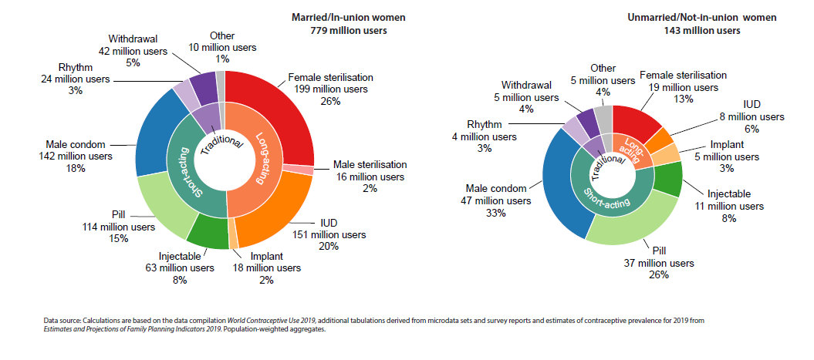
Estimated numbers of women of reproductive age (15-49 years) using various contraceptive methods, by marital status, 2019
Contraceptive use by method
Contraceptive Use by Method 2019: Data Booklet (ST/ESA/SER.A/435). United Nations; 2019.
Notes:
Methods used by married women are different from those used by unmarried women
Among the 779 million contraceptive users among women of reproductive age (15-49 years) who are married,* permanent and long-acting methods constitute close to 50 per cent of contraceptive methods used (49.3 per cent), including female sterilisation (25.5 per cent) and IUD (19.4 per cent). Among the 143 million users who are unmarried women, only 22.8 per cent of users rely on permanent and long-acting methods (most users of these methods are formerly married women) and the most common methods used are male condom (33.1 per cent) and the pill (26.1 per cent).
* “Married” pertains to women who are married (defined in relation to the marriage laws or customs of a country) and to women in a union, which refers to women living with their partner in the same household (also referred to as cohabiting unions, consensual unions, unmarried unions, or “living together”). “Unmarried” pertains to women who are not married and not in a union and is a complement to “Married”.
Source: United Nations, Department of Economic and Social Affairs, Population Division. Contraceptive Use by Method 2019: Data Booklet (ST/ESA/SER.A/435). United Nations; 2019.

Slide 23
Family planning and Human Rights
All individuals and couples have the right:
“…to decide freely and responsibly the number, spacing and timing of their children and to have the information, education, and means to do so, and the right to attain the highest standard of sexual and reproductive health...”
– ICPD Programme of Action
Training Resource Package for Family Planning – Benefits of Family Planning.
Notes:
The 1994 International Conference on Population and Development (ICPD) in Cairo was a milestone in the history of population and development, as well as in the history of women's rights. At the conference the world agreed that population is not just about counting people, but about making sure that every person counts.
Providing family planning services allows women and couples to delay and space pregnancies and limit the size of their families to the number of children they desire and are able to care for.
When women and couples reduce the risks associated with pregnancies that occur too early or late in life, having too many pregnancies, and pregnancies spaced too closely, they reap the benefits of healthier outcomes for all members of the family.
Healthier families are a benefit to the larger community. Access to FP also helps ensure that the human right to reproductive health is protected and upheld.
FP services are most effective when clients are free to make informed contraceptive choices that take into account fertility intentions and desired family size.

Slide 24
References
Guttmacher Institute. Adding It Up - Investing in Sexual and Reproductive Health in Low- and Middle-Income Countries. Fact Sheet. Guttmacher Institute, 2020 Jul. Available from: https://www.guttmacher.org/sites/default/files/factsheet/adding-it-up-investing-in-sexual-reproductive-health.pdf.
Training Resource Package for Family Planning - Benefits of Family Planning. Fptraining.org; c2021. Available from: https://apps.who.int/iris/bitstream/handle/10665/260156/9780999203705-eng.pdf?sequence=1
United Nations, Department of Economic and Social Affairs, Population Division. Contraceptive Use by Method 2019: Data Booklet (ST/ESA/SER.A/435). United Nations; 2019. Available from: https://www.un.org/development/desa/pd/sites/www.un.org.development.desa.pd/files/files/documents/2020/Jan/un_2019_contraceptiveusebymethod_databooklet.pdf
World Health Organization Department of Reproductive Health and Research (WHO/RHR) and Johns Hopkins Bloomberg School of Public Health/Center for Communication Programs (CCP), Knowledge for Health Project. Family Planning: A Global Handbook for Providers (2018 update). Baltimore and Geneva: CCP and WHO; 2018. Available from: https://www.fphandbook.org/
WHO. Contraception: Evidence brief. World Health Organization; 2019. Available from: https://apps.who.int/iris/bitstream/handle/10665/329884/WHO-RHR-19.18-eng.pdf?ua=1
WHO. Family planning/contraception methods. World Health Organization; 2020. Available from: https://www.who.int/news-room/fact-sheets/detail/family-planning-contraception
WHO. Contraception. World Health Organization; 2021. Available from: https://www.who.int/health-topics/contraception#tab=tab_3

